Slide 1



12 Factor Terraform
Richard Vodden, Babylon Health
24th June 2020

Slide 2
What are we trying to solve?
Remove Bottlenecks
Our cloud team is small, we need every engineer in the company to be able to commission infrastructure.
Increase Pace
We want to move quickly, we can’t have releases which need infrastructure changes to take lots longer than code releases.
Ensure Consistency
Data sovereignty requirements mean we have multiple production instances in different regions. We need to make sure that these are all tracking the same configuration.
Enforce Compliance
As a healthcare company there are both regulatory and compliance requirements on our infrastructure which we need to enforce, and demonstrate to auditors that they have been enforced.

Slide 3
How would this be solved in any other programming language?

Slide 4
What are the 12 Factors?
Adam Wiggins, Heroku 2011
I
Exactly one codebase
VII
Port Binding (don’t use app servers)
II
Dependencies should be declared
VIII
Concurrency through scaling processes
III
Configuration should be stored in the environment
IX
Disposability: Fast start-up & graceful shutdown
IV
Backing services should be attached and detached by the environment
X
Development/Production Parity
V
Build, Release, Run should be strictly separated
XI
Logs are event streams. The execution environment should aggregate.
VI
Applications should be stateless processes
XII
Admin Processes should be kept in source control

Slide 5
What are the 12 8 Factors?
Which of these work with terraform?
I
Exactly one codebase
VII
Port Binding (don’t use app servers)
II
Dependencies should be declared
VIII
Concurrency through scaling processes
III
Configuration should be stored in the environment
IX
Disposability: Fast start-up & graceful shutdown
IV
Backing services should be attached and detached by the environment
X
Development/Production Parity
V
Build, Release, Run should be strictly separated
XI
Logs are event streams. The execution environment should aggregate.
VI
Applications should be stateless processes
XII
Admin Processes should be kept in source control

Slide 6
What are the 9 Factors?
Let’s add one!
I
Exactly one codebase
VII
Port Binding (don’t use app servers)
II
Dependencies should be declared
VIII
Dynamically scale using elastic services
III
Configuration should be stored in the environment
IX
Disposability: Fast start-up & graceful shutdown
IV
Backing services should be attached and detached by the environment
X
Development/Production Parity
V
Build, Release, Run should be strictly separated
XI
Logs are event streams. The execution environment should aggregate.
VI
Applications should be stateless processes
XII
Admin Processes should be kept in source control

Slide 7
What are the 9 Factors?
I. Exactly one codebase
“A twelve-factor app is always tracked in a version control system, such as Git, Mercurial, or Subversion. A copy of the revision tracking database is known as a code repository, often shortened to code repo or just repo.”
“Multiple apps sharing the same code is a violation of twelve-factor. The solution here is to factor shared code into libraries which can be included through the dependency manager.”

Slide 8
What do we need to work out?
The 4 Big Challenges – what don’t we normally do?
factor shared code into libraries which can be included through the dependency manager
separate build, release & run
explicitly declare and isolate dependencies
store [environment specific] configuration in the environment

Slide 9
How Babylon solved this
The four layer hierarchy
Environment
Service
Component
Module

Slide 10
How Babylon solved this
The four layer hierarchy
Environment
An environment is a collection of Services which are combined together to support a set of microservices delivering real functionality.
Service
A service is the declaration of the components used by a particular “app”, along with any non-environment specific configuration.
Component
A component is a collection of cloud resources (i.e. modules) which combine do deliver some end to end value.
Module
There is a 1:1 relationship between modules and cloud resources types. The module enforces naming conventions, tagging, and opinions.

Slide 11
How Babylon solved this
The four layer hierarchy
μS
μS
μS
μS
μS
μS
Elastic Search
v2.3
DB
v1.2
DB
v1.1
Redis
v0.2
Services are made up of explicit versions of Components, (which in turn are made up of explicit versions of Modules).
Foo v3.2
Bah v0.1
Doh v1.7
Environments are made up of explicit versions of Services with their environment specific configuration

Slide 12
μS
μS
μS
μS
μS
μS
Production v1.2
Elastic Search
v2.3
DB
v1.2
DB
v1.1
Redis
v0.2
Services are made up of explicit versions of Components, which in turn are made up of explicit versions of Modules.
Foo v3.2
Bah v0.1
Doh v1.7
RDS
v2.6
CloudWatch
v1.2
IAM
v1.2
ElastiCache
v1.7
RDS
v2.7
Environments are made up of explicit versions of Services with their environment specific configuration

Slide 13
How Babylon solved this
The four layer hierarchy
The Production v1.2 Environment consumes three services:
Foo v3.2;
Bar v0.1
Doh v1.7
The Doh v1.7 service consumes two components:
DB v1.1
Redis v0.2
The DB v1.1 service consumes of two modules:
RDS v2.7
IAM v1.2

Slide 14
How Babylon solved this
The four layer hierarchy
The Production v1.2 Environment consumes three services:
Foo v3.2;
Bar v0.1
Doh v1.7
The Doh v1.7 service consumes two components:
DB v1.1
Redis v0.2
The DB v1.1 service consumes of two modules:
RDS v2.7
IAM v1.2

Slide 15
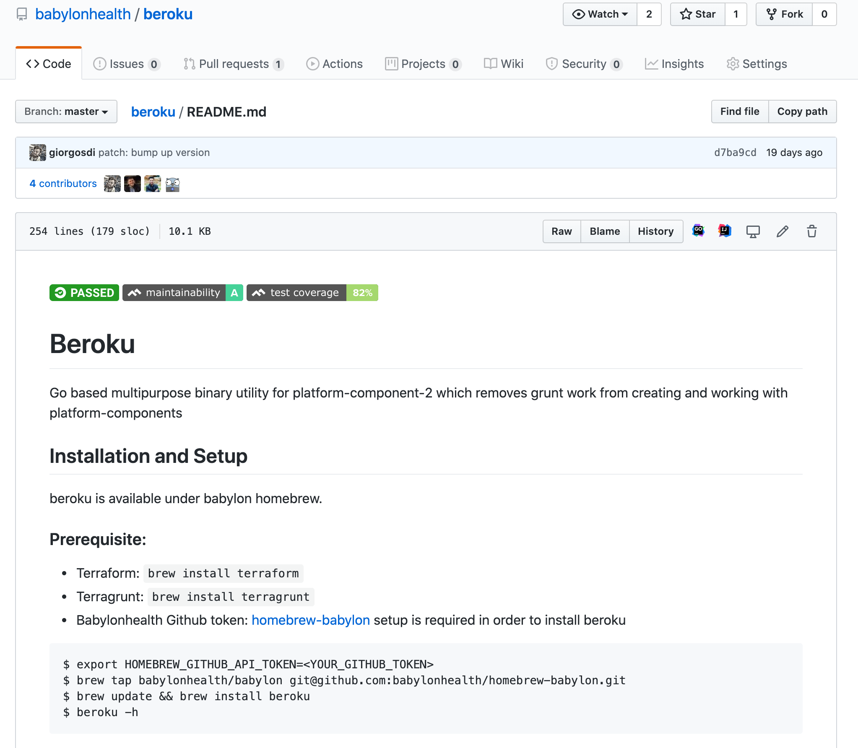
How Babylon solved this
Dependency Hell?
Beroku – the dependency manager for terraform.
only uses git tags
will update versions of services, components & modules
very Babylon specific at the moment!

Slide 16
How Babylon solved this
Let’s talk testing
Environment
Production “Testing”:
RunScope API testing, monitoring etc.
Regularly run a plan – has my environment changed?
Service
End to End Tests:
Deploy the infra and the application and run the application test suite.
Component
Integration Tests:
Can I get the creds for the database out of Vault, log in and insert some data?
Can I get the creds for the database, try and delete the database and be denied?
Module
Unit tests:
Does the resource deploy?
Does it have the right tagging?
Have the opinions we had about it been applied?

Slide 17
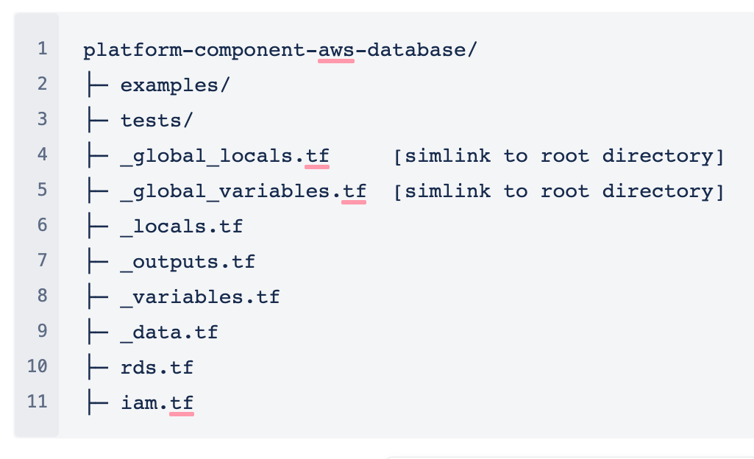
How Babylon solved this
Every entity has its own repository

Slide 18
What are we trying to solve?
Remove Bottlenecks
Teams can consume components by adding them to their services without Cloud Engineering being involved.
Increase Pace
Our state files are now reduced to the size of individual services, so plans and deployments take a small number of minutes.
Ensure Consistency
The use of services means we know we’re consistent across environments
The use of components and modules (and beroku to keep us up to date) means we know we’re consistent across services.
Enforce Compliance
By baking the opinions into the modules and then using AWS Tagging to show which module created each resource we can quickly and easily demonstrate that resources have not been changed, and are therefore compliant.

Slide 19
Thank you
For listening
Richard Vodden
@rvodden
richard.vodden@babylonhealth.com

